Slide 1
Warm-Up
1) Beulah died in the Appalachians while Craig died at sea. Everyone was much happier with Craig's death. Why?
2) What number comes next? 2, 2, 4, 12, 48, ___
3) What does the following imply?
VICE+VICE
Notes:
Both were hurricanes.
240. To get the number, multiply the previous number in the series by its position. 48 is in the 5th position, so 48 × 5 = 240
Advice
1) Only 1 (me)
2)
4 (3 and 5 are prime) 6 (5 and 7 are prime) 12 (11 and 13 are prime) 18 (17 and 19 are prime) 30 (29 and 31 are prime) 42 (41 and 43 are prime) 60 (59 and 61 are prime) 72 (71 and 73 are prime) 102 (101 and 103 are prime) 108 (107 and 109 are prime) thus 138 (137 and 139 are prime), 150 (149 and 151 are prime), 180 (179 and 181 are prime)

Slide 2
Inheritance

Slide 3
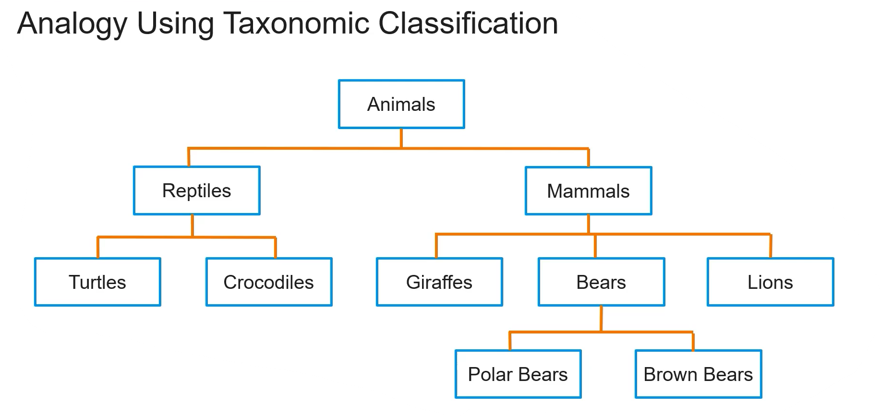
An Example from Biology

Slide 4
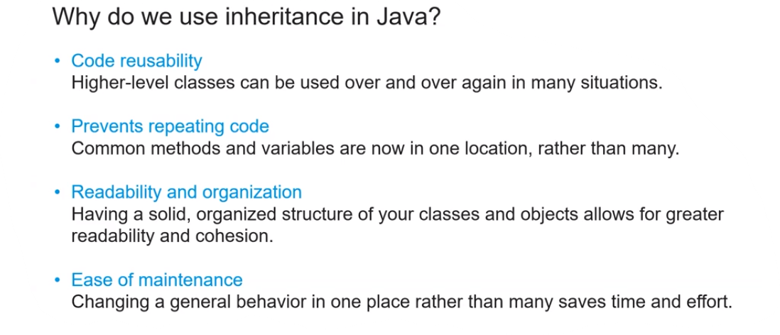
Why Inheritance?

Slide 5
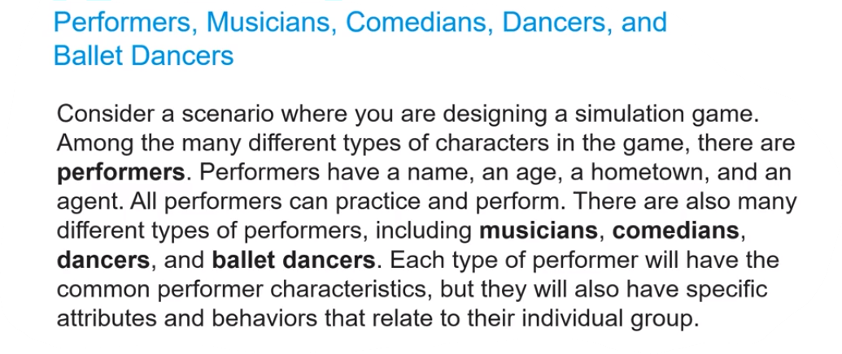
An Inheritance Scenario

Slide 6
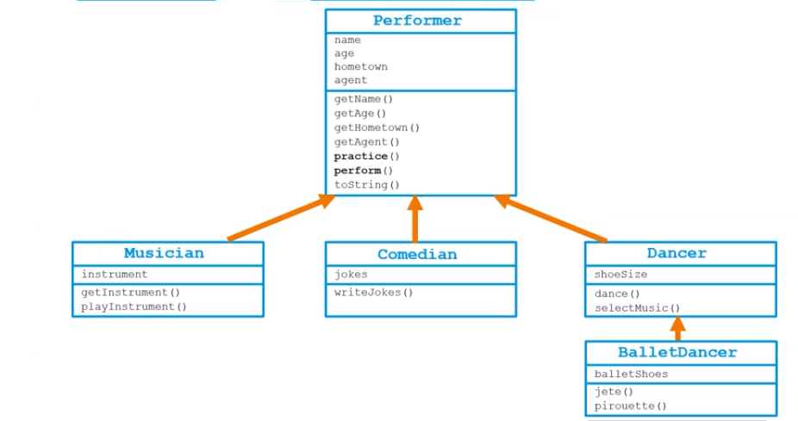
Scenario Continued

Slide 7
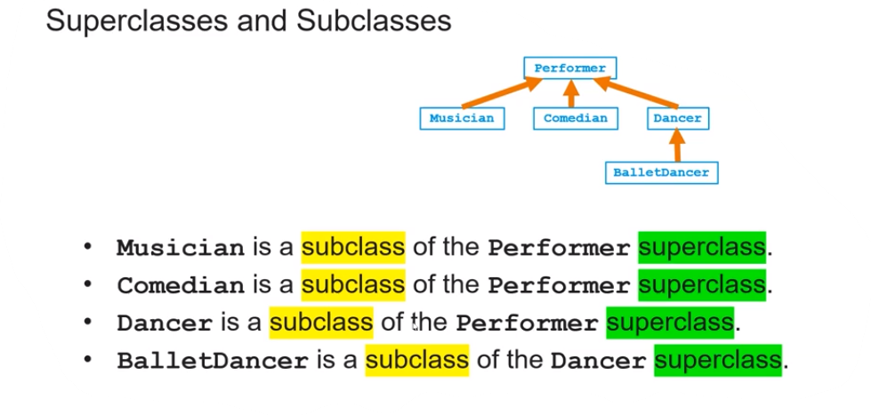
Superclass vs. Subclass

Slide 8
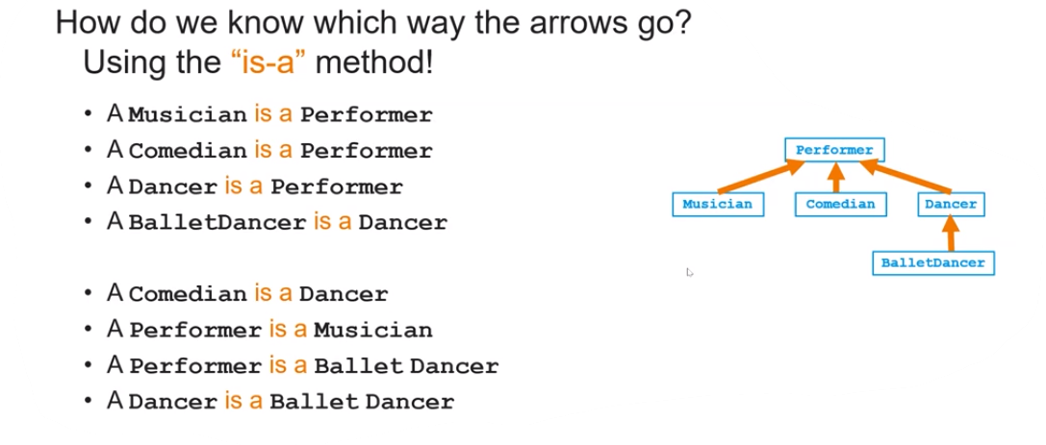

Is-a Relationships

Slide 9
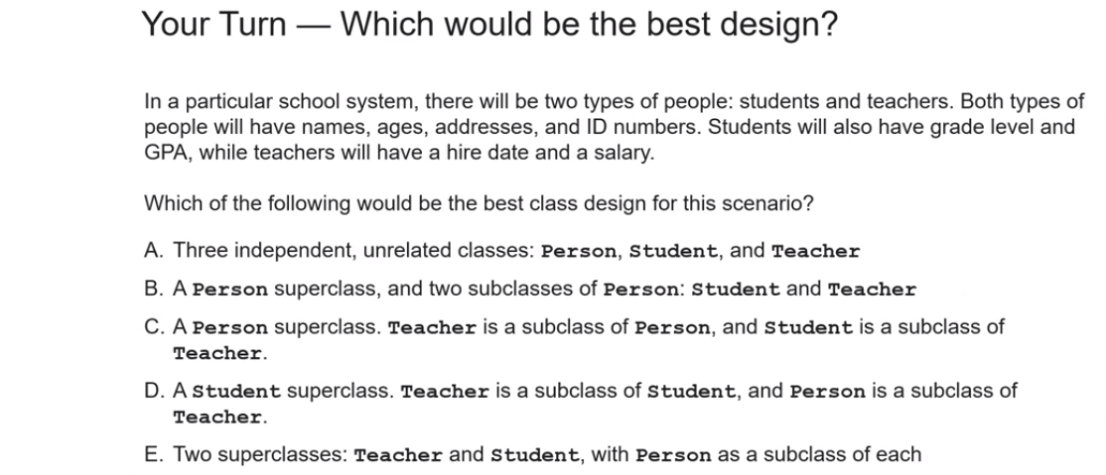
Example Multiple Choice Question

Slide 10
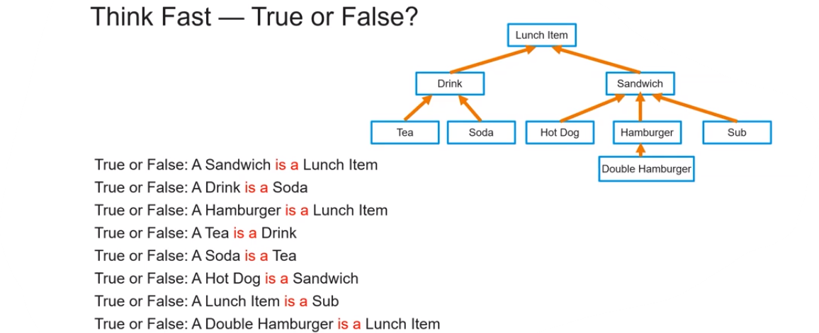
Practice Problems

Slide 11
Inheritance Syntax
public class name extends superclass
Example:
public class Rectangle extends Polygon
- Rectangle is called the subclass.
- Polygon is the superclass

Slide 12
Inheritance
Inheritance: A way to form new classes based on existing classes, taking on their attributes and behavior.
A way to group related classes.
A way to share code between two or more classes.
One class can extend another, inheriting its data/behavior.
Superclass: The “original” class, the one being extended.
(also called the base or parent class)
Subclass: The class that extends the superclass and inherits its behavior. (also called the derived or child class)
A subclass gets a copy of every public field and method from the superclass.
(No access to any private fields or methods!)

Slide 13
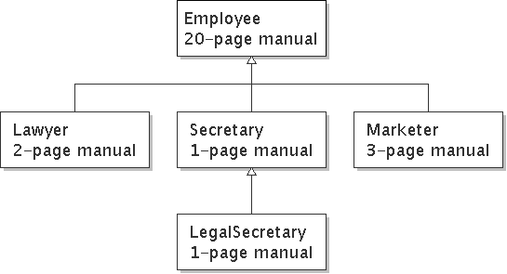
Is-a Relationships
Is-a Relationship: A hierarchical connection where one category can be treated as a specialized version of another.
(The arrow designates the is-a relationship)
ex) a Marketer is an Employee

Slide 14
An Employee Class
public class Employee
{
public int getHours()
{
return 40; // works 40 hours per week
}
public double getSalary()
{
return 40000; // $40,000 per year
}
public int getVacationDays()
{
return 10;
}
public String getVacationForm()
{
return "yellow"; // use the yellow form
}
}

Slide 15
Secretary Class
public class Secretary
{
public int getHours()
{
return 40;
}
public double getSalary()
{
return 40000;
}
public int getVacationDays()
{
return 10;
}
public String getVacationForm()
{
return "yellow";
}
public void takeDictation(String text)
{
System.out.println("Taking dictation of text: " + text);
}
}

Slide 16
Desire for Code-Sharing
takeDictation is the only unique behavior in Secretary.
Wouldn’t it be easier if we could do this?
public class Secretary
{
copy all the contents from the Employee class;
public void takeDictation(String text)
{
System.out.println("Taking dictation of text: " + text);
}
}

Slide 17
Improved Secretary Class
public class Secretary extends Employee
{
public void takeDictation(String text)
{
System.out.println("Taking dictation of text: " + text);
}
}
Now we only write the parts unique to each type.
The Secretary class inherits getHours, getSalary, getVacationDays, and getVacationForm methods from Employee.
Secretary adds the takeDictation method.

Slide 18
Overriding Methods
Override: To write a new version of a method in a subclass which replaces the original method from the superclass.
Must keep the return type and signature (name and parameters) the same.
public class Lawyer extends Employee
{
public String getVacationForm()
{
return "pink";
}
}

Slide 19
Overriding Methods Cont.
How can we access overriden methods?
public String getVacationForm()
{
return super.getVacationForm() +"pink";
}
We user “super.” to differentiate between which method we want to call. In this case, super.getVacationForm() will call the method from the Employee class.

Slide 20
Problem with Constructors
Constructors are not inherited: If no constructor is written for a subclass, the superclass’s default constructor is generated for you.
If the superclass does not have a default constructor, a compile error will occur.
We call the superclass constructor using the keyword, super.
Syntax: super(parameters);
The super call must be the first statement in the constructor.

Slide 21
Problem with Constructors
public Employee(String n, int h)
{
name = n;
hours = h;
}
public Lawyer(String name, int hours, int b)
{
super(name, hours);
bonus = b;
}
***super must be the first call in a constructor***

